Slide 1


HTML Advanced

Slide 2
Agenda
01
HTML Video
02
HTML Audio
03
HTML Tables
04
HTML Lists

Slide 3
HTML Video

Slide 4
HTML Video
In HTML, Video tag is used to play videos like movies or any short video on the web page.
<video width="300" height="200" controls>
<source src="movie.mp4" type="video/mp4">
This browser does not support the video tag.
</video>

Slide 5
HTML Video
The text between <video> and </video> tags will only be displayed in browsers that do not support the <video> element.
<video width="300" height="200" controls>
<source src="movie.mp4" type="video/mp4">
This browser does not support the video tag.
</video>

Slide 6
HTML Video
To play a video automatically, we can use the autoplay attribute.
<video width="300" height="200" autoplay>
<source src="movie.mp4" type="video/mp4">
This browser does not support the video tag.
</video>
NOTE: CHROME DO NOT ALLOW AUTOPLAY IN MOST CASES, BUT MUTED AUTOPLAY IS ALWAYS ALLOWED

Slide 7
HTML Video
The Muted attribute specifies that the audio output of the video should be muted.
<video width="300" height="200" controls muted>
<source src="movie.mp4" type="video/mp4">
This browser does not support the video tag.
</video>

Slide 8
HTML Video
Using the Height and Width attributes is always a good idea, if they are not used then the web page may get stuck.
<video width="300" height="200" autoplay>
<source src="movie.mp4" type="video/mp4">
This browser does not support the video tag.
</video>

Slide 9
Hands On: HTML Video

Slide 10
HTML Audio

Slide 11
HTML Audio
In HTML Audio tag defines sounds such as music and other audio clips
<audio controls>
<source src=“song.mp3" type="audio/mp3">
Your browser does not support the audio element.
</audio>

Slide 12
HTML Audio
By using controls attribute we can add audio controls like play, pause and volume.
<audio controls>
<source src=“song.mp3" type="audio/mp3">
Your browser does not support the audio element.
</audio>

Slide 13
HTML Audio
To start the audio automatically, autoplay attribute can be used and to mute the audio file automatically muted attribute is added after autoplay.
<audio controls autoplay >
<source src=“song.mp3" type="audio/mp3">
Your browser does not support the audio element.
</audio>
<audio controls muted>
<source src=“song.mp3" type="audio/mp3">
Your browser does not support the audio element.
</audio>
NOTE: CHROME DO NOT ALLOW AUTOPLAY IN MOST CASES, BUT MUTE IS ALWAYS ALLOWED

Slide 14
Hands On: HTML Audio

Slide 15
HTML Tables

Slide 16
HTML Tables
The HTML tables allows us to arrange the data into rows and columns
<table>
<tr>
<th>NAME</th>
<th>CITY</th>
<th>MOBILE</th>
</tr>
<tr>
<td>Akash</td>
<td>Bangalore</td>
<td>23562356</td>
</tr>
<tr>
<td>Raj</td>
<td>Mumbai</td>
<td>75896319</td>
</tr>
</table>

Slide 17
HTML Tables
A table consists of table cells inside rows and columns, each table cell is defined by a <td> and </td> tag.
<table>
<tr>
<th>NAME</th>
<th>CITY</th>
<th>MOBILE</th>
</tr>
<tr>
<td>Akash</td>
<td>Bangalore</td>
<td>23562356</td>
</tr>
<tr>
<td>Raj</td>
<td>Mumbai</td>
<td>75896319</td>
</tr>
</table>

Slide 18
HTML Tables
The table row starts with a <tr> and ends with a </tr> tag.
<table>
<tr>
<th>NAME</th>
<th>CITY</th>
<th>MOBILE</th>
</tr>
<tr>
<td>Akash</td>
<td>Bangalore</td>
<td>23562356</td>
</tr>
<tr>
<td>Raj</td>
<td>Mumbai</td>
<td>75896319</td>
</tr>
</table>

Slide 19
HTML Tables
When we want the cells to be headers, at that time we can use <th> tag instead of <td> tag.
<table>
<tr>
<th>NAME</th>
<th>CITY</th>
<th>MOBILE</th>
</tr>
<tr>
<td>Akash</td>
<td>Bangalore</td>
<td>23562356</td>
</tr>
<tr>
<td>Raj</td>
<td>Mumbai</td>
<td>75896319</td>
</tr>
</table>

Slide 20
Hands On: HTML Table

Slide 21
HTML Lists

Slide 22



HTML Lists
HTML Lists allow us to group together related items in a list

Slide 23
HTML Lists
In HTML there are 3 kinds of lists: Ordered, Unordered and Description
Ordered List
Unordered List
Description List

Slide 24
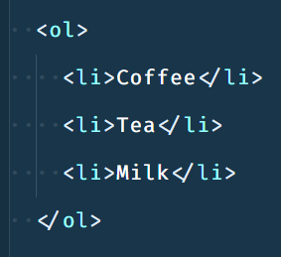
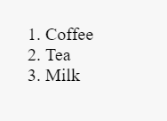
HTML Lists
Ordered Lists are lists in which order matters, i.e. ranks of students, steps in a recipe etc.
Ordered List
Unordered List
Description List

Slide 25
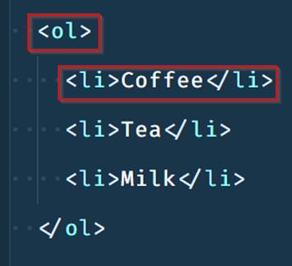
HTML Lists
We create an Ordered List using <ol> tag and each list item within it is wrapped inside an <li> tag
Ordered List
Unordered List
Description List

Slide 26
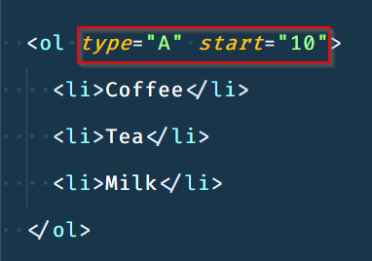
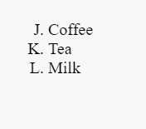
HTML Lists
By default ordered list items are numbered from 1 but we can specify the type of order as well as the value the list should start from
Ordered List
Unordered List
Description List

Slide 27
Hands On: Ordered Lists

Slide 28
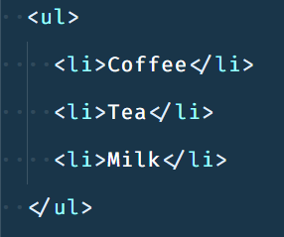
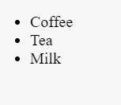
HTML Lists
Unordered Lists are lists in which order does not matter, i.e. people who attended an event, ingredients in a recipe etc.
Ordered List
Unordered List
Description List

Slide 29
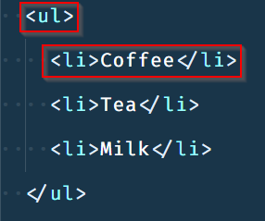
HTML Lists
We create an Unordered List using <ul> tag and each list item within it is wrapped inside an <li> tag
Ordered List
Unordered List
Description List

Slide 30
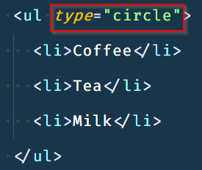
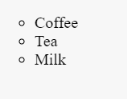
HTML Lists
By default unordered list items are bulleted with a filled circle called a disc but we can specify the type of bullets such as square, circle etc.
Ordered List
Unordered List
Description List

Slide 31
Hands On: Unordered Lists

Slide 32
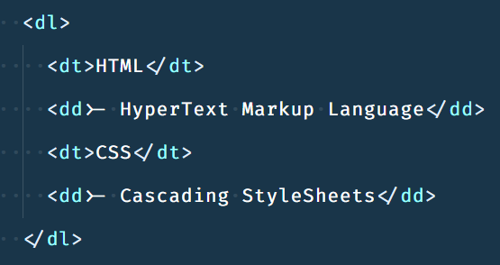
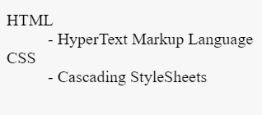
HTML Lists
Description Lists are lists which contains a few terms and their descriptions
Ordered List
Unordered List
Description List

Slide 33
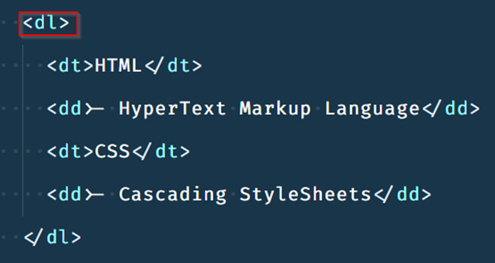
HTML Lists
We create an Unsorted List using <dl> tag and each list item has two parts term and its description
Ordered List
Unordered List
Description List

Slide 34
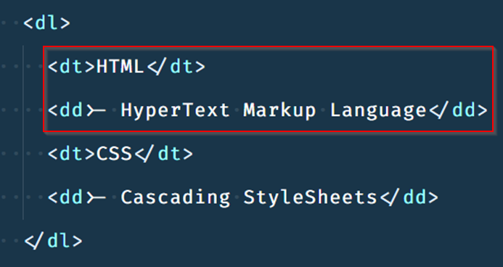
HTML Lists
We use the <dt> tag for the term and dd tag for it’s description
Ordered List
Unordered List
Description List

Slide 35
Hands On: Description Lists

Slide 36


India: +91-7847955955
US: 1-800-216-8930 (TOLL FREE)
support@intellipaat.com
24/7 Chat with Our Course Advisor
Notes:
Thank you!

